Slide 2
Call to Worship

Slide 3
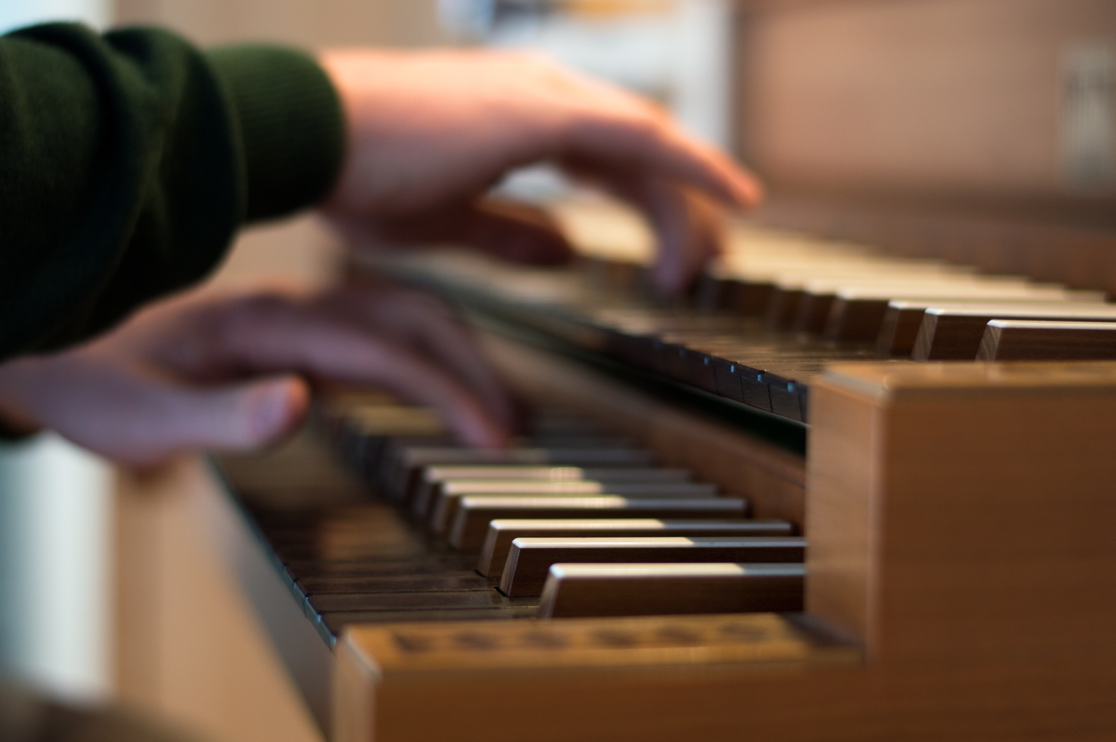
Opening Hymn #567

Slide 4
#567, Have Thine Own Way
Have Thine own way, Lord!
Have Thine own way! Thou art the Potter, I am the clay Mold me and make me after Thy will While I am waiting, yielded and still

Slide 5
#567, Have Thine Own Way
Have Thine own way, Lord!
Have Thine own way! Search me and try me, Master, today! Whiter than snow, Lord,
wash me just now As in Thy presence humbly I bow

Slide 6
#567, Have Thine Own Way
Have Thine own way, Lord!
Have Thine own way!
Hold o'er my being, absolute sway!
Filled with Thy spirit 'till all can see
Christ only, always, living in me...

Slide 7
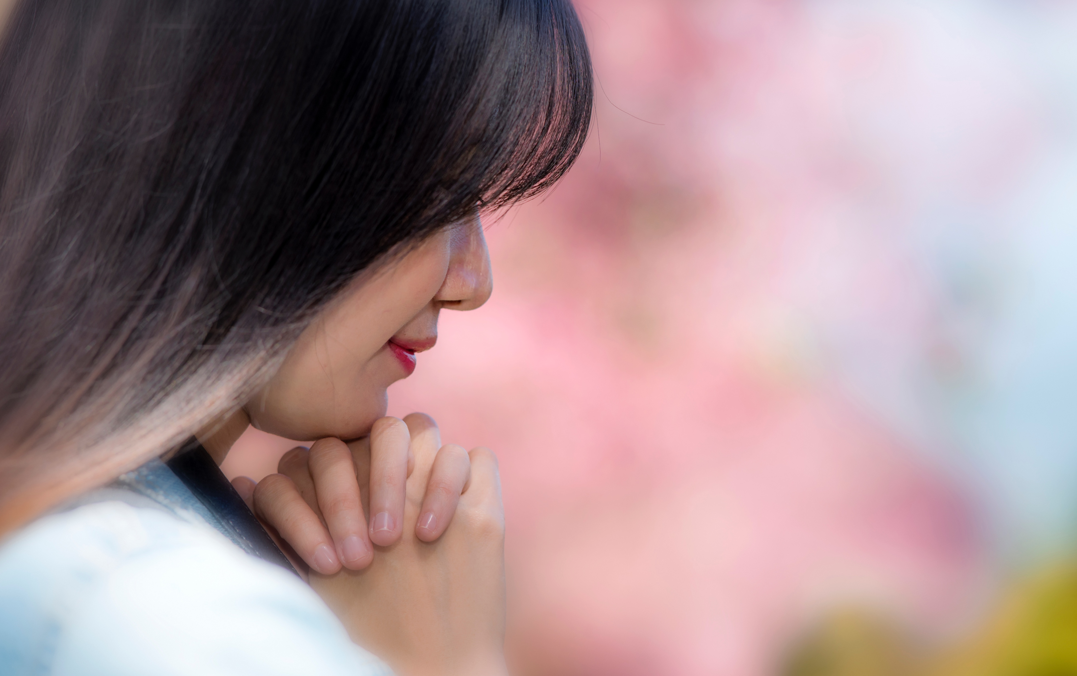
PASTORAL PRAYER

Slide 8
OFFERTORY APPEAL

Slide 9
CHILDREN’S STORY

Slide 10
Scripture Reading

Slide 11
Genesis 12:1-3
¹ Now the Lord had said unto Abram, Get thee out of thy country, and from thy kindred, and from thy father's house, unto a land that I will shew thee:

Slide 12
Genesis 12:1-3
² And I will make of thee a great nation, and I will bless thee, and make thy name great; and thou shalt be a blessing:

Slide 13
Genesis 12:1-3
³ And I will bless them that bless thee, and curse him that curseth thee: and in thee shall all families of the earth be blessed.

Slide 14
Special Music

Slide 16
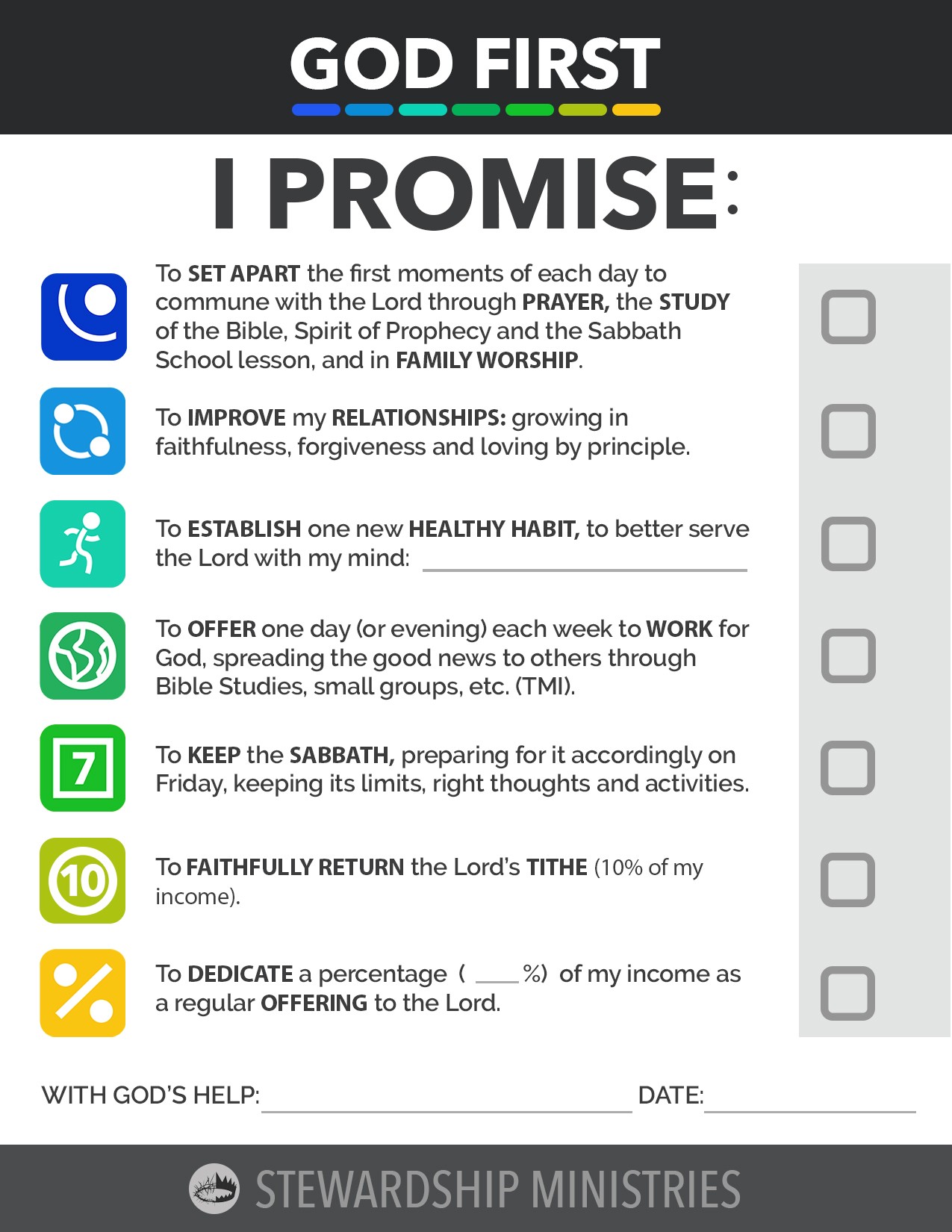
Commitment Ceremony

Slide 17
TITLE

Slide 19
TITLE

Slide 20
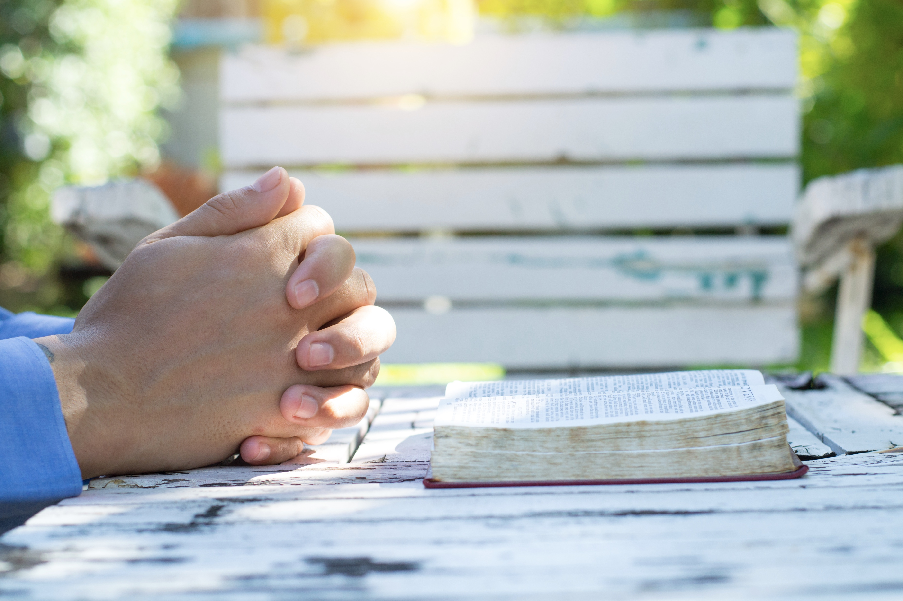
Closing Hymn #322

Slide 21
#322 Nothing Between
Nothing between my soul and the Savior, Naught of this world's delusive dream; I have renounced all sinful pleasure; Jesus is mine, there's nothing between.

Slide 22
#322 Nothing Between
Nothing between my soul and the Savior, So that His blessed face may be seen; Nothing preventing the least of His favor, Keep the way clear! Let nothing between.

Slide 23
#322 Nothing Between
Nothing between, like worldly pleasure; Habits of life, though harmless they seem, Must not my heart from Him ever sever; He is my all! There's nothing between.

Slide 24
#322 Nothing Between
Nothing between my soul and the Savior, So that His blessed face may be seen; Nothing preventing the least of His favor, Keep the way clear! Let nothing between.

Slide 25
#322 Nothing Between
Nothing between, e'en many hard trials, Though the whole world against me convene; Watching with prayer and much self-denial, I'll triumph at last, with nothing between.

Slide 26
#322 Nothing Between
Nothing between my soul and the Savior, So that His blessed face may be seen; Nothing preventing the least of His favor, Keep the way clear! Let nothing between.

Slide 27
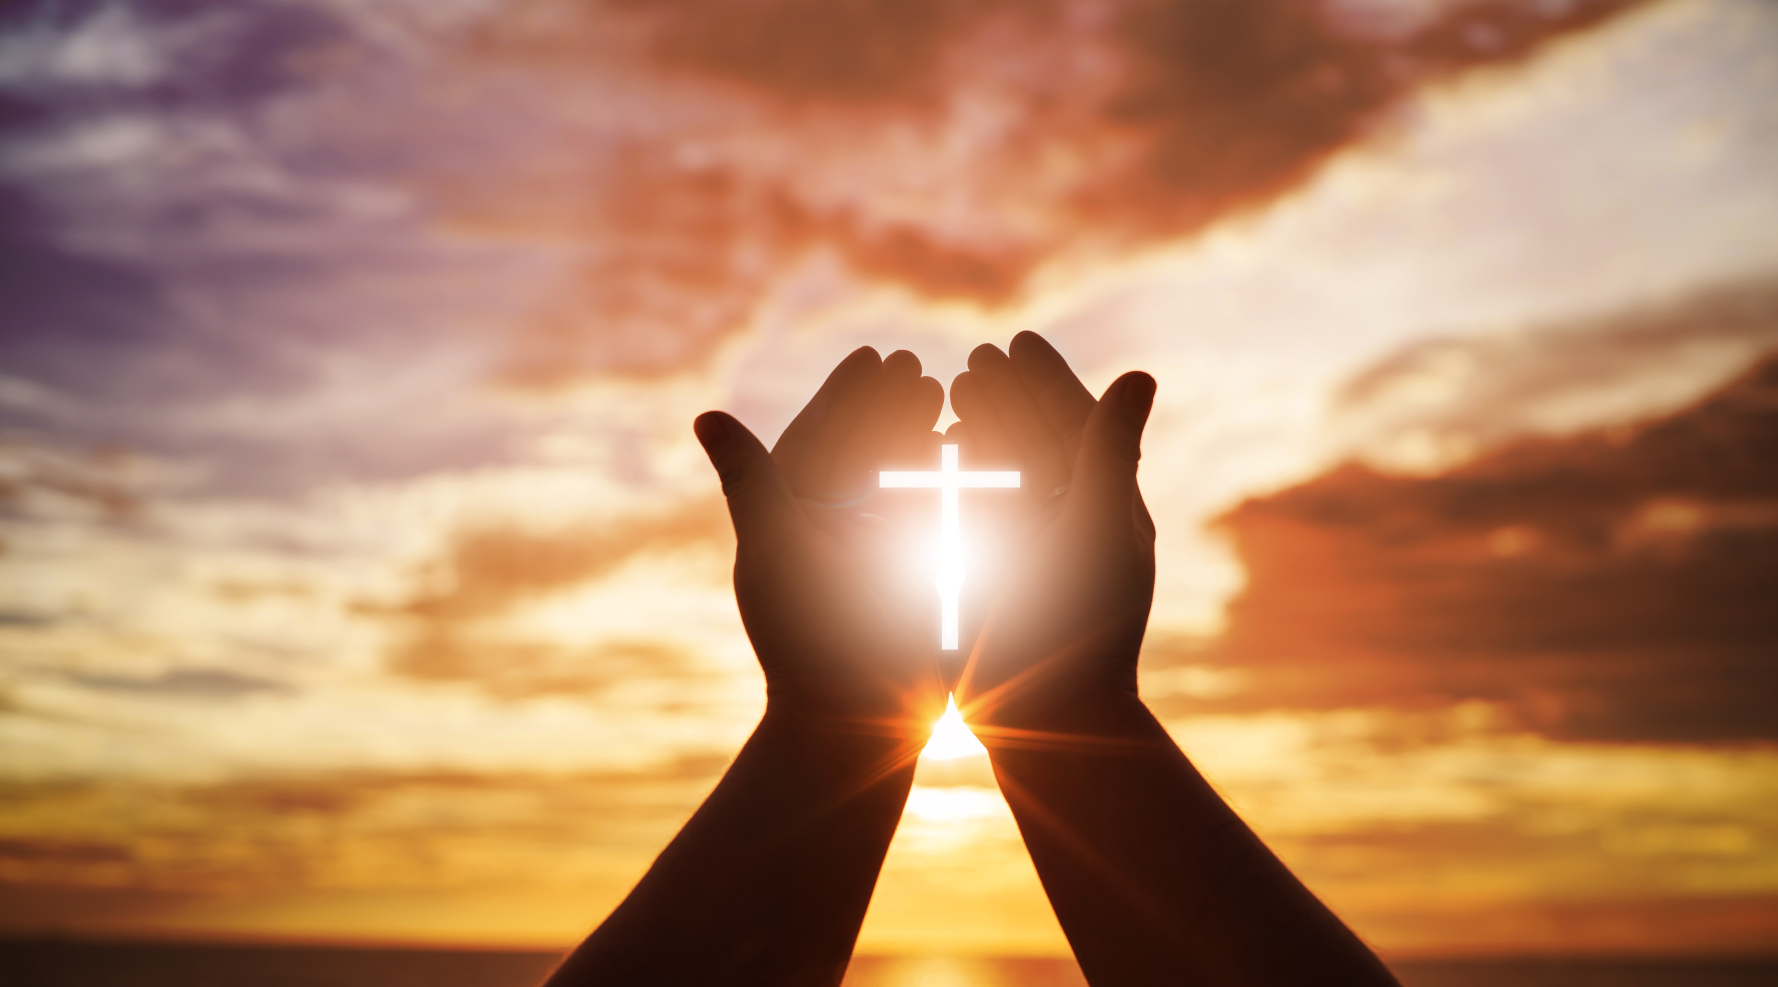
Benediction

